Slide 2
Why the Value of Clean is worth the fight
Employee’s on average take 7.7 sick days per year
Costs in the USA total $2.25 Billion per year
Unplanned absences cause a 54% decrease in productivity and a 39% drop in customer service
Cleaning protocols can reduce common colds and influenza by 80%
Dirty schools increase costs and decrease reimbursements
Teachers average 5.3 sick days per year and must be replaced by subs
Students miss an average of 4.5 days decreasing federal funds by 2.5% per year
Cleaning protocols can reduce absenteeism by up to 46%
Customers prefer cleanliness
94% of shoppers will avoid a business with a dirty restroom
In a food restaurant, Cleanliness is the number 1 item mentioned in satisfaction surveys
Consumers rank Cleanliness number 1 in most important criteria for where to shop.

Slide 3
THERE IS AN
UNMET NEED
IN CHEMICAL
APPLICATION.
Across industries there is a need for advanced technology that applies cleaning, coating and disinfectants more effectively, more efficiently and with greater convenience

Slide 4
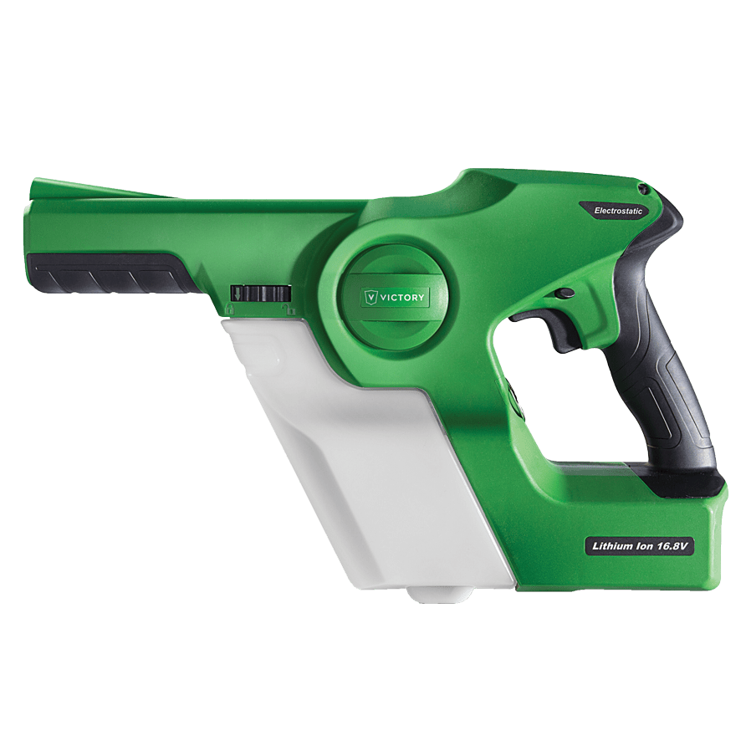
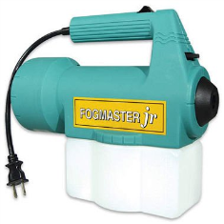
METHODS OF APPLICATION
Most Effective
ELECTROSTATICS
Effectiveness
FOGGERS
SPRAYERS
Least Effective
WIPES
Least Cost Effective
Labor + Chemical = Cost
Most Cost Effective

Slide 5
What are Electrostatic Sprayers?
+
-
+
-
Electrostatic sprayers change the electrical charge of the particles in whatever solution is sprayed to go from Neutral (+’s and –’s) to either Positive (+) or Negative (-).
+
+
+
+
+
Because of this charge, sprayed charged particles will have an attraction up to 75 times that of gravity and will seek out items to land on versus “floating” in the air.
75X
+
+
+
+
+
+
+
+
As the like charged particles land, they avoid colliding in the air or landing on each other since they have the same charge so they spread out evenly across all sprayed surfaces providing excellent solution coverage.
+
+
+
+
+
+
+
+
If the sprayed particles have the opposite charge as the material they are sprayed on, the electrical force will even cause the particles to reverse course and coat hidden and hard to reach surfaces that would typically be missed by conventional spraying or wiping.
+
+
+
+
-
+
+
-
+
-

Slide 6
Benefits of Electrostatic Sprayers
SAVES TIME
SAVES MONEY
PROVIDES BETTER COVERAGE
Tests Versus A Hand Pump Sprayer Show That An Electrostatic Sprayer Applies Chemicals Up to 70% Faster.
Tests Versus A Hand Pump Sprayer Show That An Electrostatic Sprayer Uses Up to 65% Less Chemical To Cover The Same Area.
Because Electrostatic Sprayers Charge The Solutions Particles, The Particles Spread Better Versus Piling Up And Continue Looking For Clean Space To Land Giving You Better Coverage.

Slide 7
WHY VICTORY INNOVATIONS ELECTROSTATIC SPRAYERS?
Ease of Use
Cordless
Lightweight
Ergonomic
Simple to Use and Understand
2. Versatility
Accepts all chemicals approved to be sprayed
3 in 1 nozzle allows you to match dwell times to chemicals requirements
2 sprayer options (handheld and back pack) designed for space and customer preferences
Performance
Patented double charge system provides optimal charge on sprayed particles
16.8V lithium ion battery provides 4 hours of continuous runtime on a single charge
Safety
Grounded – Grounding strap built into the handle
Approved by all global and U.S. electrical and safety standard laboratories

Slide 8
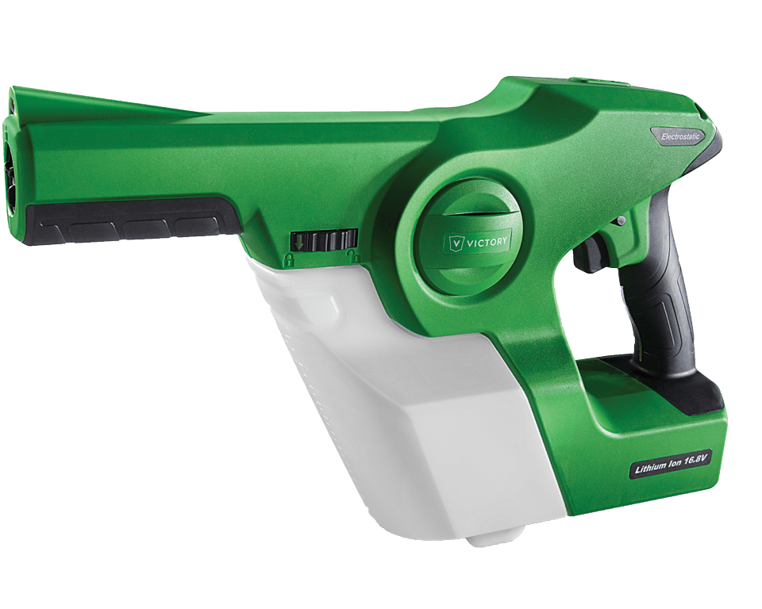
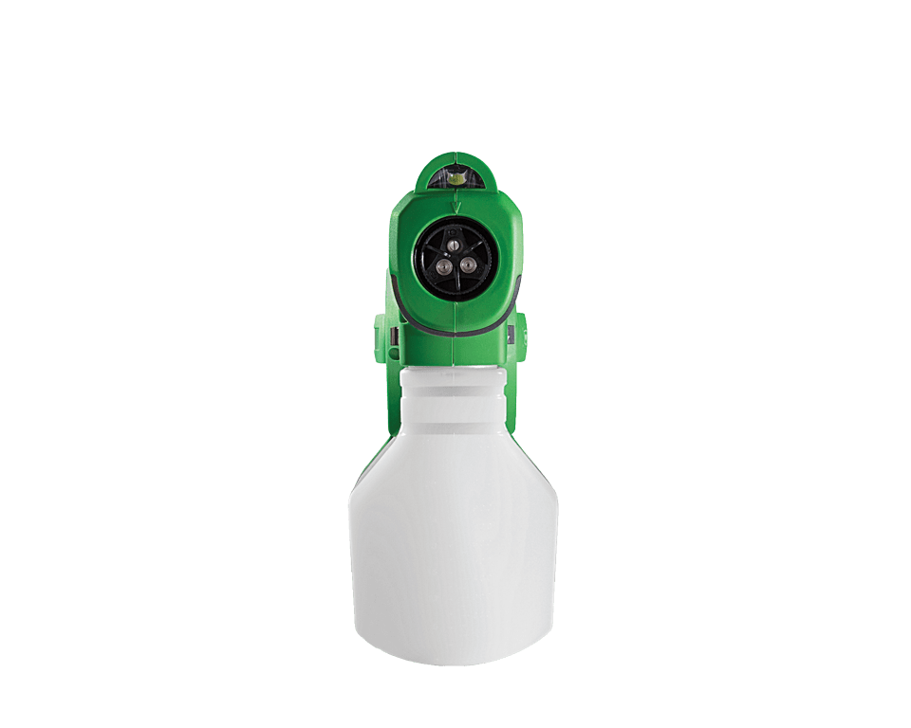
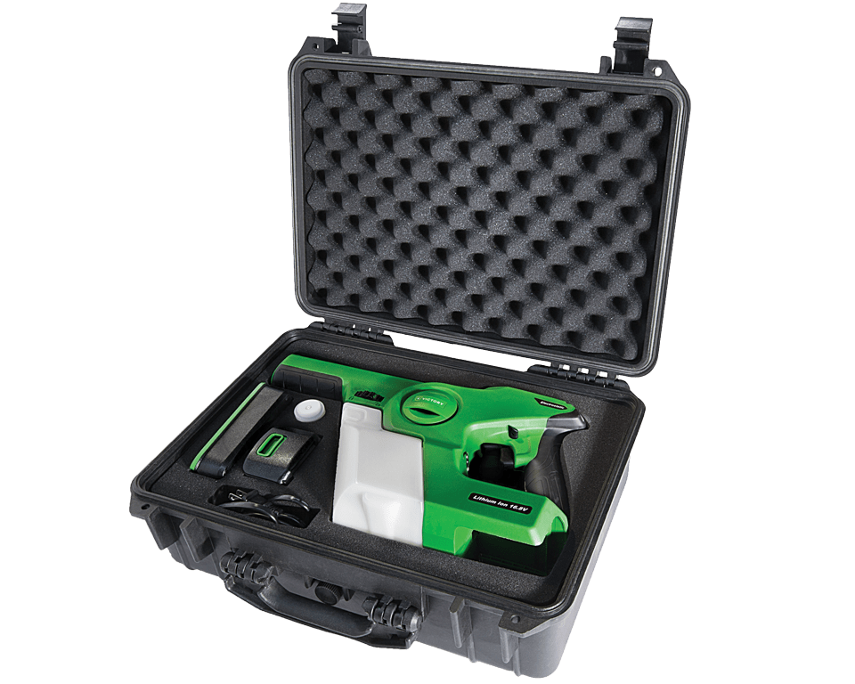
EASE OF USE – HANDHELD FEATURES
Head Light
Lightweight, Durable Housing
Electrostatic ON/OFF Switch
Ergonomic Handle
Trigger Lock
Easy Fill Tank
Adjustable Nozzle
Long-Lasting Battery
Deluxe Carrying Case

Slide 9
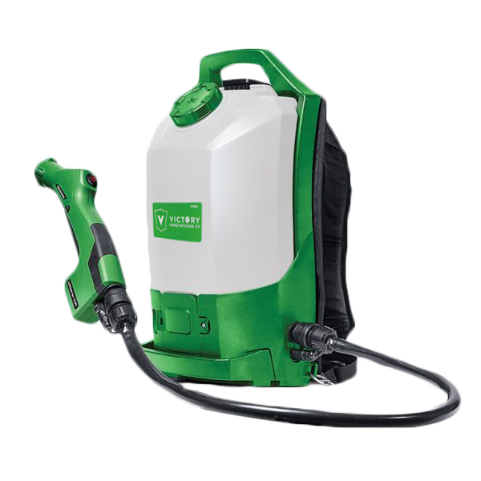
EASE OF USE – BACKPACK FEATURES
EASY FILL TANK
EASY CARRY HANDLE
3-IN-1 NOZZLE
COMFORTABLE STRAPS
ERGONOMIC HANDLE
QUICK RELEASE VALVE
4 FT HOSE
LONG LASTING BATTERY

Slide 10
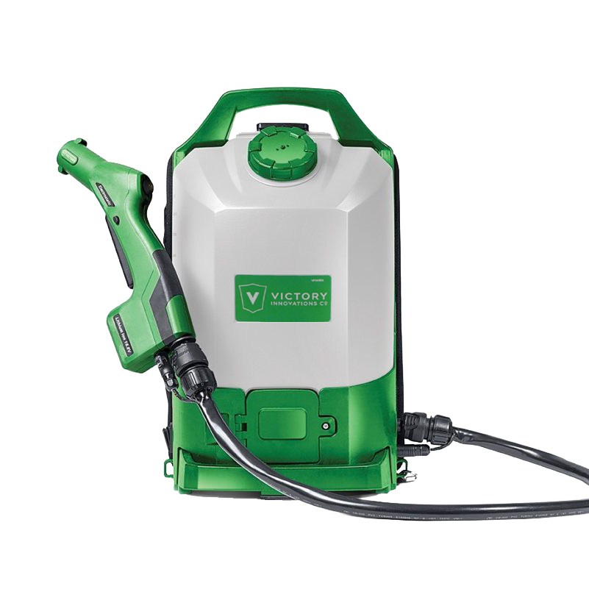
versatility
The World’s First Handheld CORDLESS Electrostatic Sprayer
DESIGNED FOR MOBILITY
Use in airports, ambulances, athletic facilities, bathrooms, correctional facilities, daycare centers, gyms, health clubs, hotels, institutional kitchens, laundry rooms, offices and schools

Slide 11
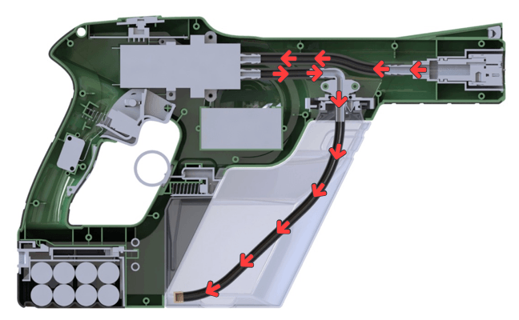
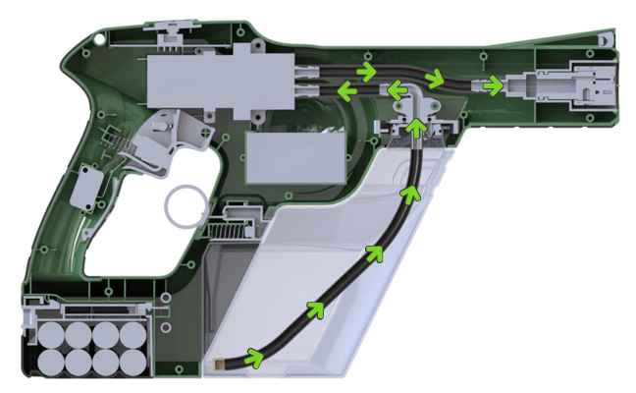
PERFORMANCE
The Only Sprayer with a Double Charge System
Suction Line
Charging Ring
Suction Line
Charging Ring
Pump
Output Line
Pump
Output Line
Charging Module
Charging Module
CHARGE 1
CHARGE 2
When the unit is turned on charge starts at charging ring and works itself back down the line, through the pump and into the tank changing all ions positive.
All the positive Ions from the tank are pumped from the tank through the pump and charged again at the charging ring all prior to becoming atomized.

Slide 12
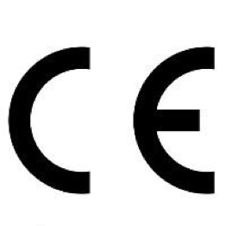
SAFETY
EDISON TESTING LABORATORIES
CANADIAN STANDARDS ASSOCIATION
FEDERAL COMMUNICATIONS COMMISSION
The ETL, Edison Testing Laboratories, Listed Mark is proof of product compliance (electrical, gas and other safety standards) to North American safety standards.
CSA certification CSA Group has the largest subject area recognition of the SDOs accredited by the Standards Council of Canada (SCC), an organization that coordinates Canada’s National Standards System.
The Federal Communications Commission (FCC) is an independent United States government agency that is directly responsible to Congress.
RESTRICTION OF HAZARDOUS SUBSTANCES
MEXICAN OFFICIAL STANDARDS
EUROPEAN COMMISSION
CSA certification CSA Group has the largest subject area recognition of the SDOs accredited by the Standards Council of Canada (SCC), an organization that coordinates Canada’s National Standards System.
RoHS, also known as Lead-Free, stands for Restriction of Hazardous Substances. RoHS, also known as Directive 2002/95/EC, originated in the European Union and restricts the use of six hazardous materials found in electrical and electronic products.
An independent organization with more than a century of experience in product safety and compliance evaluation, among which are product certifications based on Mexican Official Standards (Normas Oficiales Mexicanas – NOM) and Mexican Standards (Normas Mexicanas – NMX).

Slide 13
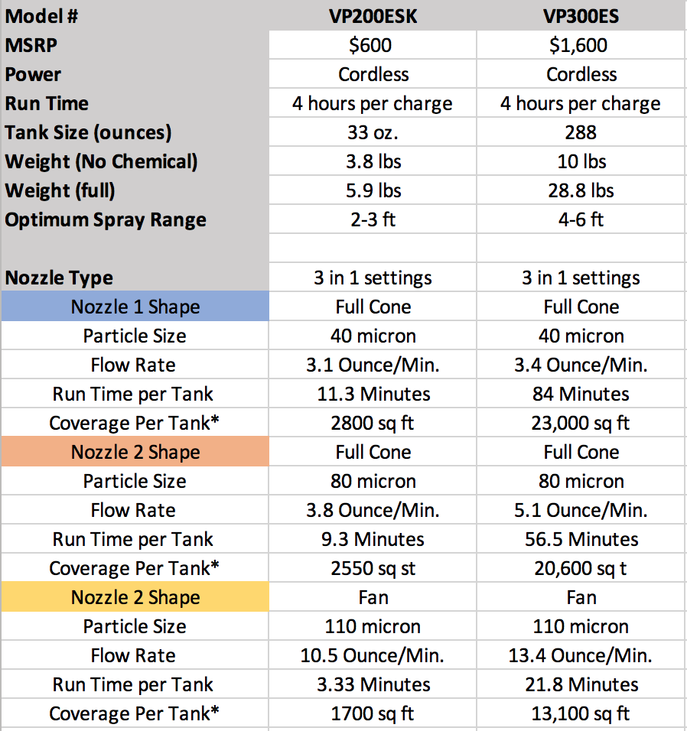
VICTORY INNOVATIONS PRODUCT SPECS
Need to add time to empty tank:
Handheld
Victory Minutes 11.3/9.3/3.3
Backpack
Victory Minutes 84.0/56.5/21.8
Clorox 360 Minutes 32
ESS Suitcase 76.3

Slide 14
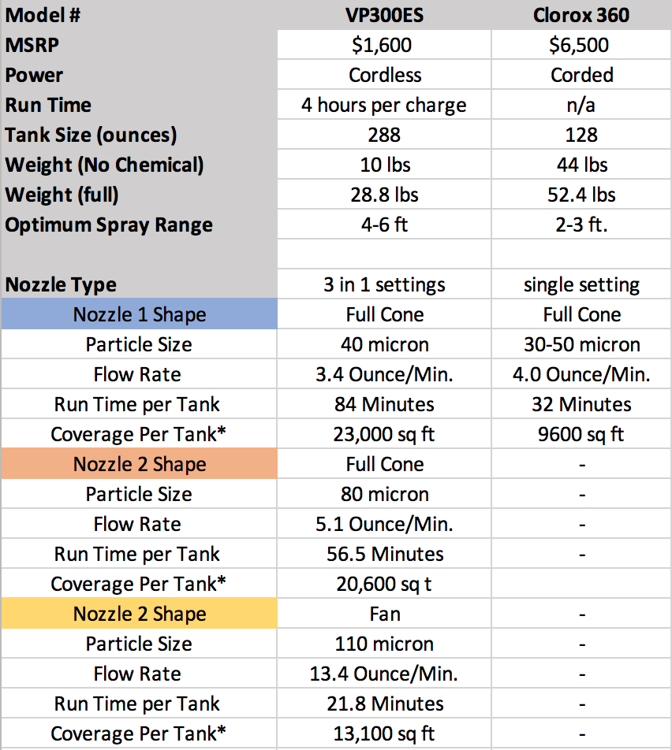
COMPARISON CHART - CORDED
Need to add time to empty tank:
Handheld
Victory Minutes 11.3/9.3/3.3
Backpack
Victory Minutes 84.0/56.5/21.8
Clorox 360 Minutes 32
ESS Suitcase 76.3

Slide 15
Selling Against Clorox 360
Overall Ease of Use
The Victory Backpack sprayer offers a more convenient solution by eliminating the cord allowing you to move from room to room, go into tighter spaces like a bus or airplane and navigate rooms without getting cords stuck.
Chemical
The Victory sprayers allow you to choose the chemical that best meets your requirements. We do not lock you into one brand like the Clorox sprayer.
Spray Size Versatility
The Victory sprayers have 3 different nozzles settings so that you can adjust the spray pattern and particle size to match a chemicals dwell time requirements. The Clorox 360 locks you into one particle size and one chemical.
Tank Size
The tank on the Victory backpack sprayer holds up to 2.25 gallons of chemical. The Clorox 360 is set to be used with a 1 gallon chemical bottle. The larger Victory sprayer tank means less down time to refill the tank.

Slide 16
Selling Against Clorox 360 (CONT.)
Weight
The Victory backpack sprayer weighs 10 lbs. without the chemical. The Clorox 360 weighs 44 lbs. Even on a cart, that is a lot of weight to pull around.
Price
Victory Sprayers are affordable at a cost of $600-$700 for the handheld sprayer and $1500-$1700 for the backpack sprayer. The Clorox 360 is selling for between $4000-$6500.

Slide 17
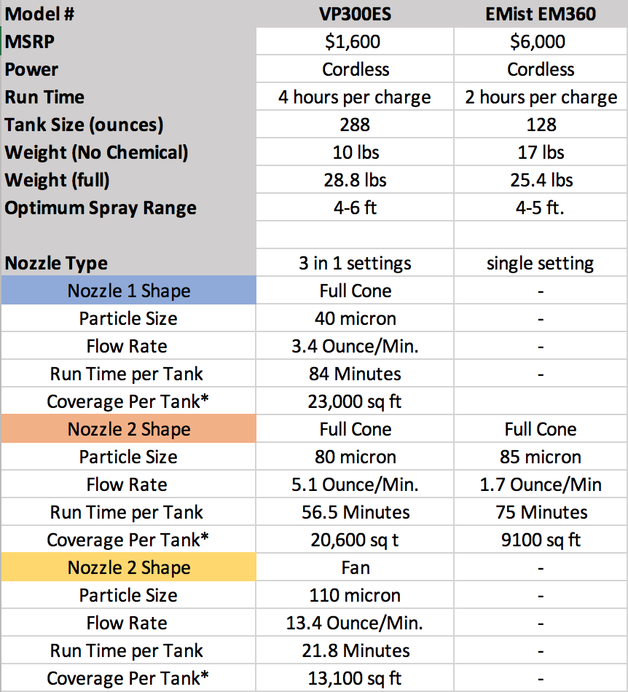
COMPARISON CHART - CORDLESS
Need to add time to empty tank:
Handheld
Victory Minutes 11.3/9.3/3.3
Backpack
Victory Minutes 84.0/56.5/21.8
Emist Minutes 75.4
ESS Minutes 13

Slide 18
Selling Against E-Mist
Overall Ease of Use
Tank connections, battery charging, back pack strap system, grounding and unit weight give several of the key benefits to the Victory Backpack sprayer over the E-Mist sprayer.
Battery
The Victory backpack will run for 4 hours on a single charge of the 15.6V lithium battery. The E-Mist unit will run for 2 hours and uses 2 XX batteries to operate.
The Victory battery charges in 90 minutes. Each E-Mist battery takes 3 hours to charge so 6 hours in total to run the unit for half the time.
Grounding
All electrostatic sprayers require the unit to be grounded. On corded sprayer this happens through the cord. On cordless units the user safely becomes the grounding mechanism. The Victory unit embeds a metal strap into the handle and as you hold the sprayer to spray, grabbing the strip the unit becomes grounded. On the E-Mist sprayer you must put an elastic strap around your foot and attach it to the bottom of the backpack. This is a bit awkward and can creates a tripping hazard.
Tank Size
The tank on the Victory backpack sprayer holds up to 2.25 gallons of chemical. The E-Mist sprayer holds up to 1 gallon of chemical. The larger Victory sprayer tank means less down time to refill the tank.

Slide 19
SELLING AGAINST E-MIST (CONT.)
Versatility
The Victory backpack sprayer gives you 3 nozzle settings so that you can set the chemical dwell time to match you application. The E-Mist sprayer has only one size for all applications.
Weight
The Victory backpack sprayer weighs 10 lbs. without the chemical. The E-Mist sprayer weighs 25 lbs.
Price
Victory Sprayers are affordable at a cost of $600-$700 for the handheld sprayer and $1500-$1700 for the backpack sprayer. The E-Mist EM360 is selling for about $6500.

